Slide 1
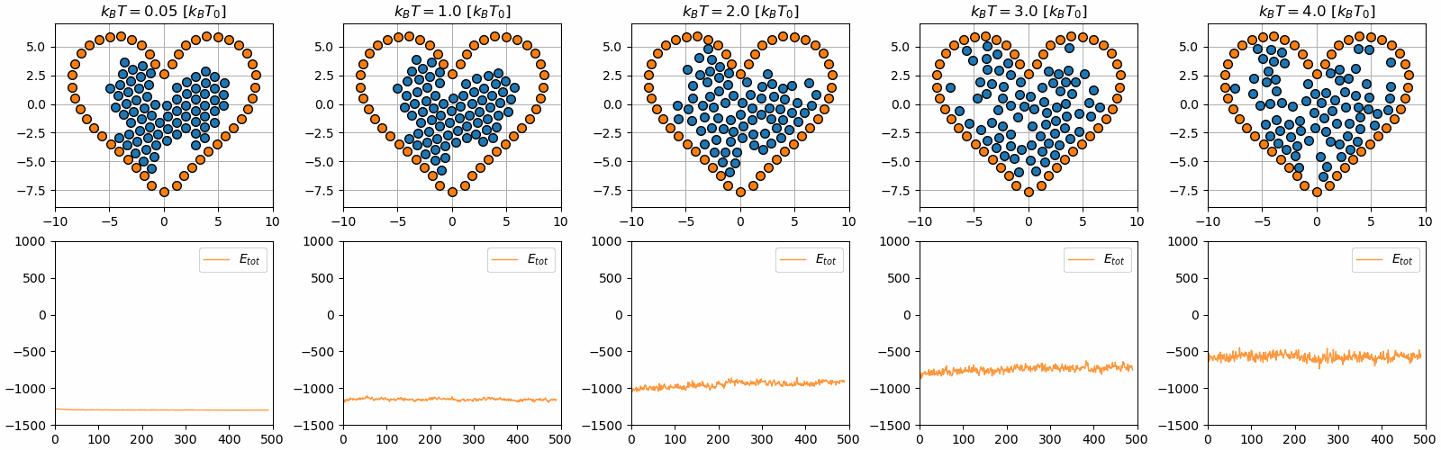
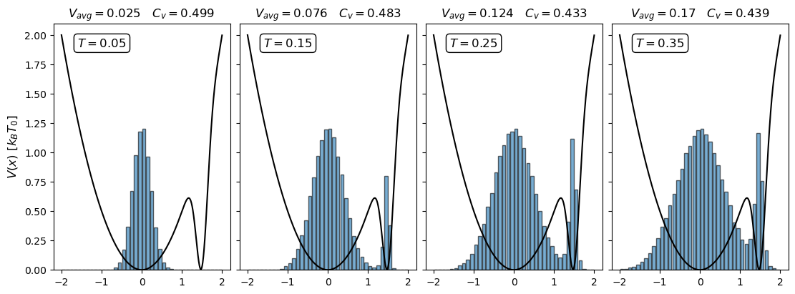
Simulation of temperature

Slide 2
Outline
Brief summary of statistical physics
Monte Carlo & Metropolis Monte Carlo sampling
Molecular Dynamics simulations (MD-simulations)
Focus on MD-Simulations
Results from exercises 27 and 28 if time permits

Slide 3
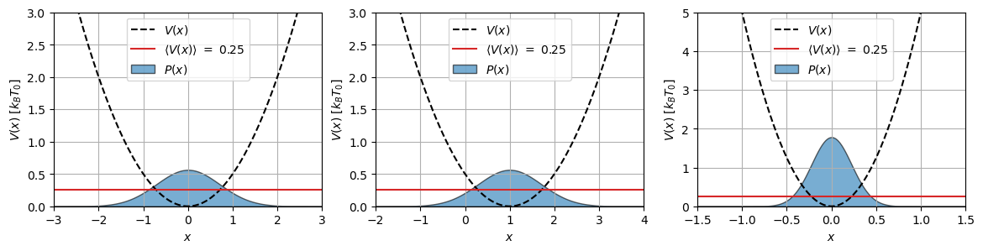
Brief summary of statistical physics
How do we describe thermodynamic systems?

Slide 4
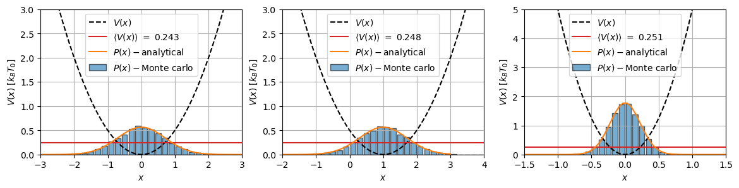
Monte Carlo sampling & Metropolis Monte Carlo sampling
Algorithm
Why use it?
Short comings:
Have to choose Y(x)

Slide 5
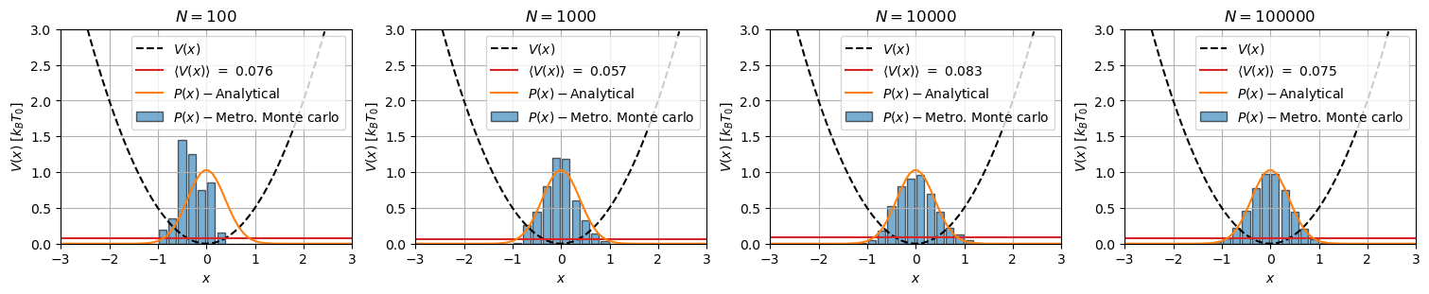
Monte Carlo sampling & Metropolis Monte Carlo sampling
Solution: Metropolis Monte carlo
Algorithm
Short comings:
What about NpT or NVT?
Timescales?
Phase transitions?

Slide 6
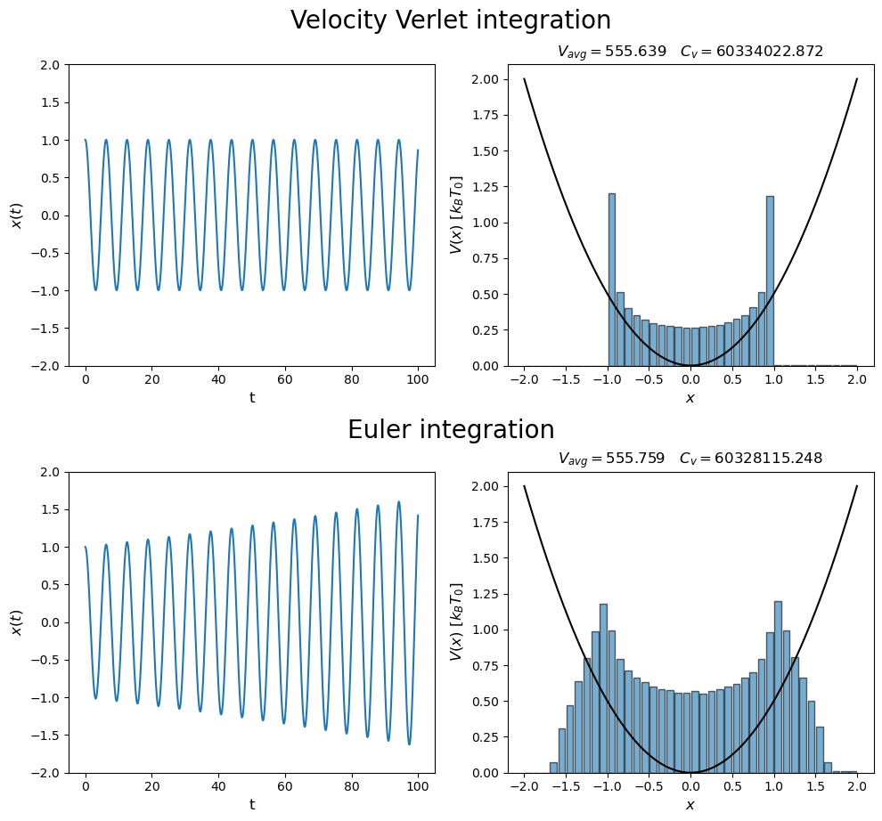
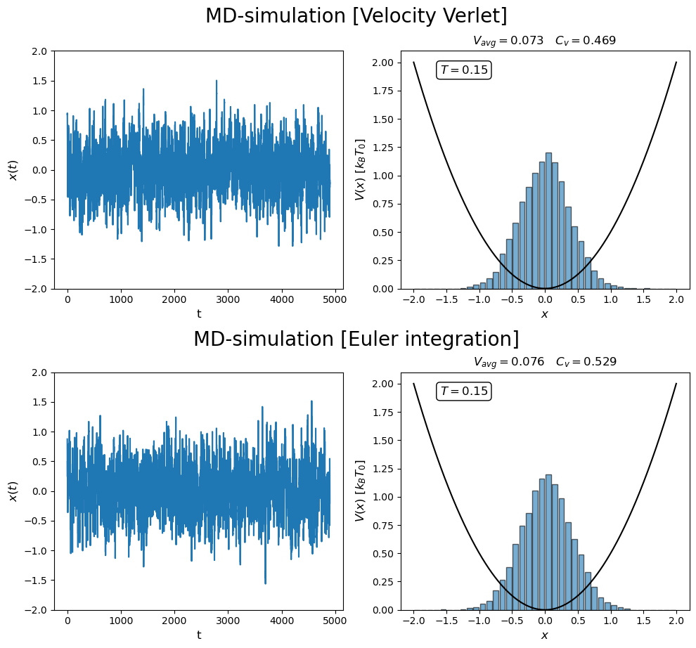
Solution: MD-simulations
Switch on thermostat

Slide 7
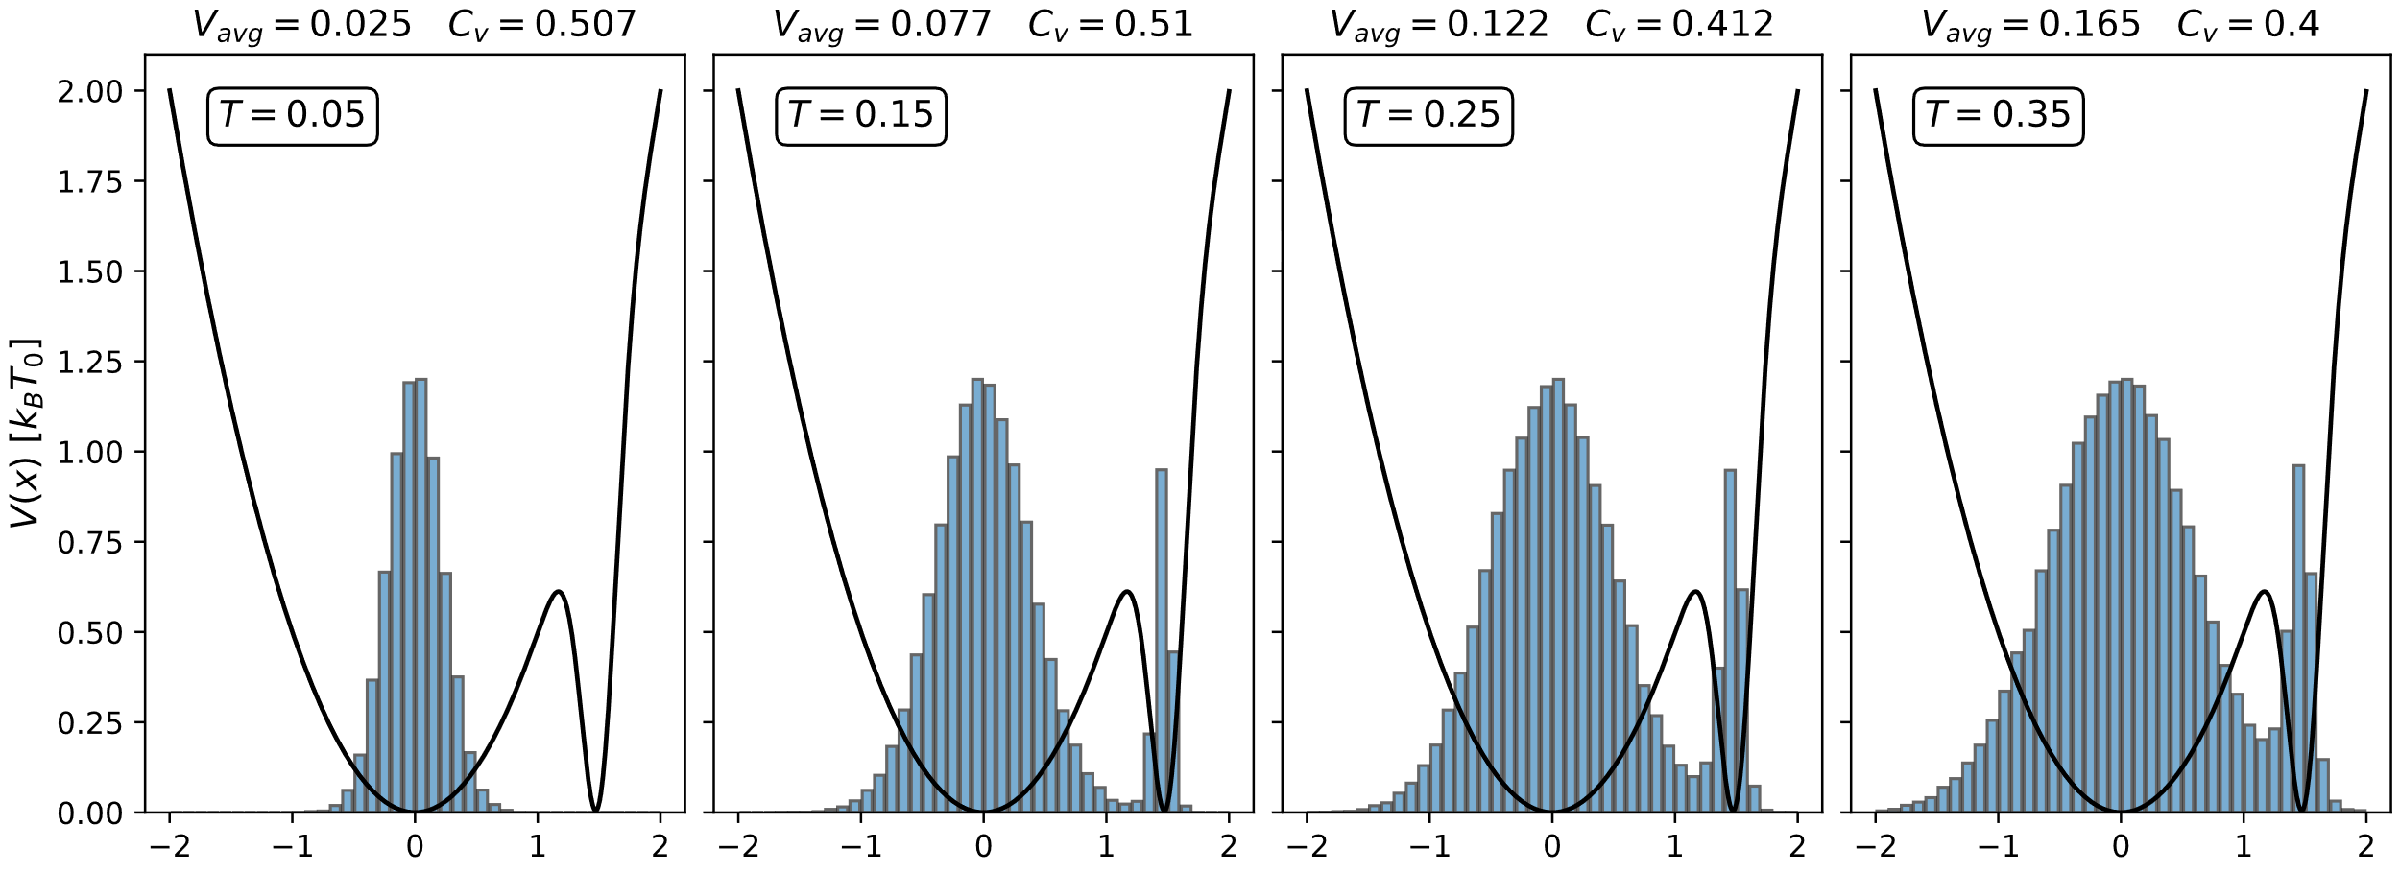
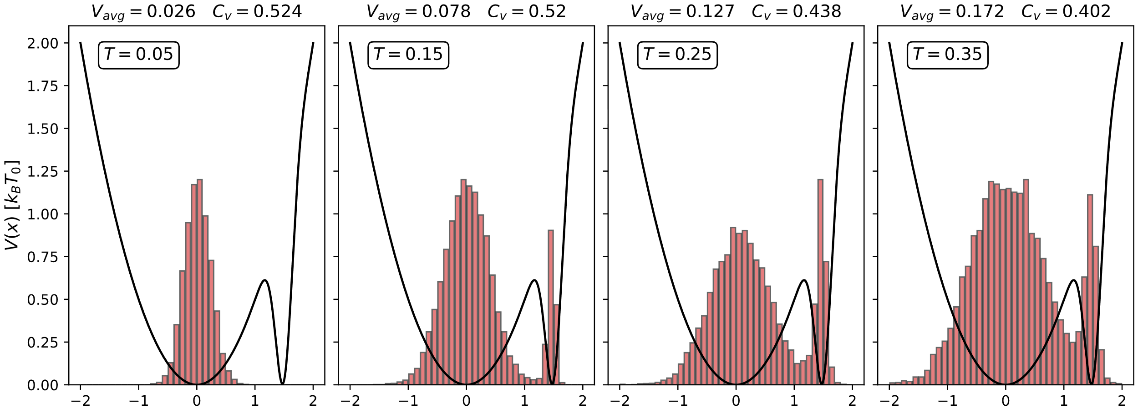
Metropolis Montecarlo vs. MD-simulation
Metropolis Montecarlo
MD-simulations

Slide 8
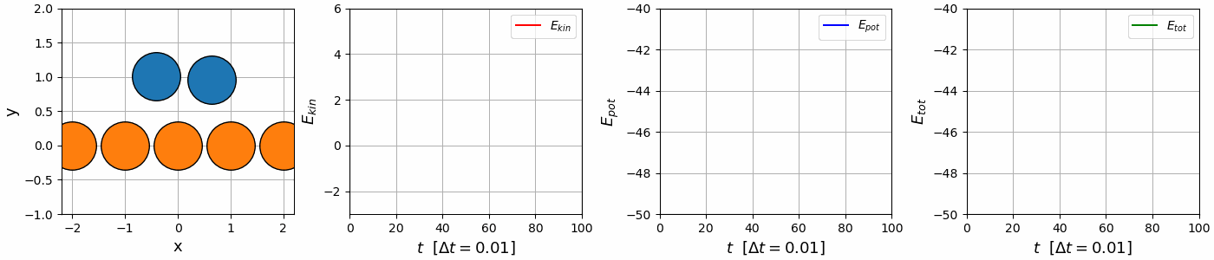
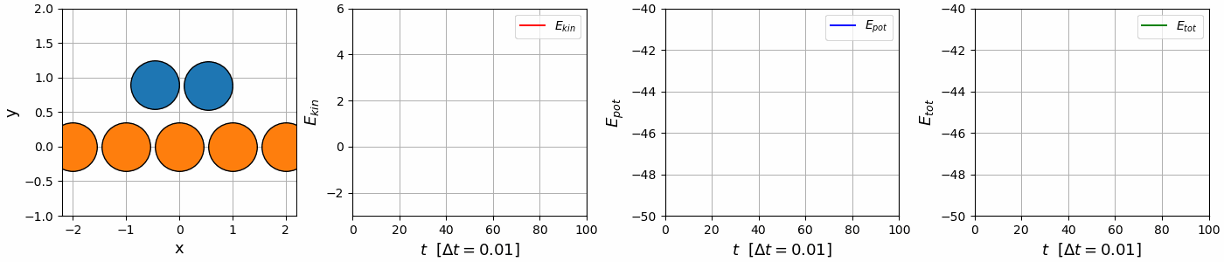
Focus on MD-simulations
Task: Simulate phase transition & annealing
MD-simulations → Integration of N2
Subject to thermostat
(NVE simulations)
Velocity
verlet
Euler integration

Slide 9
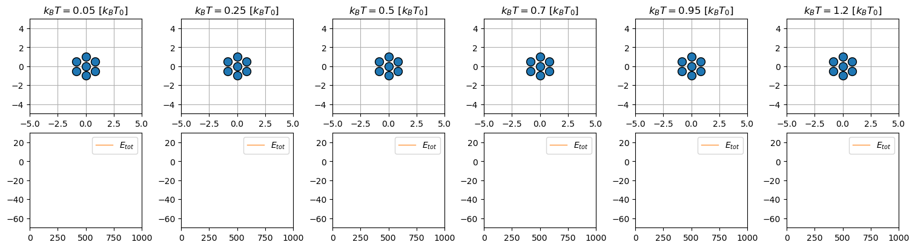
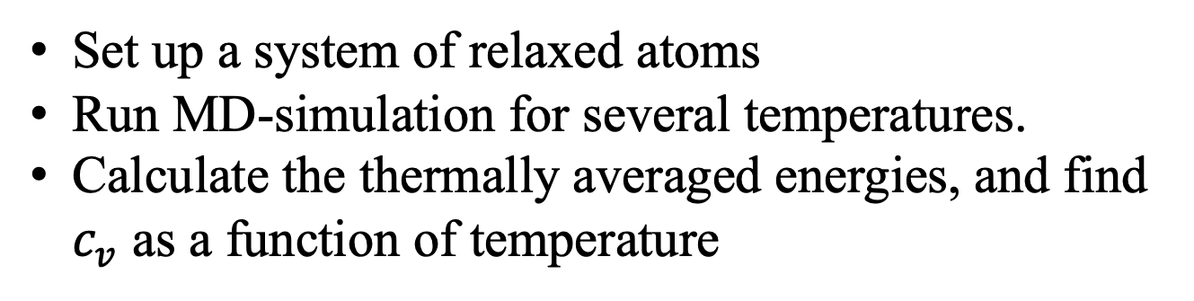
Exercise 27 – find phase transition
Set up a system of relaxed atoms
Run MD-simulation for several temperatures.
Calculate the thermally averaged energies, and find $c_{v}$ as a function of temperature

Slide 10
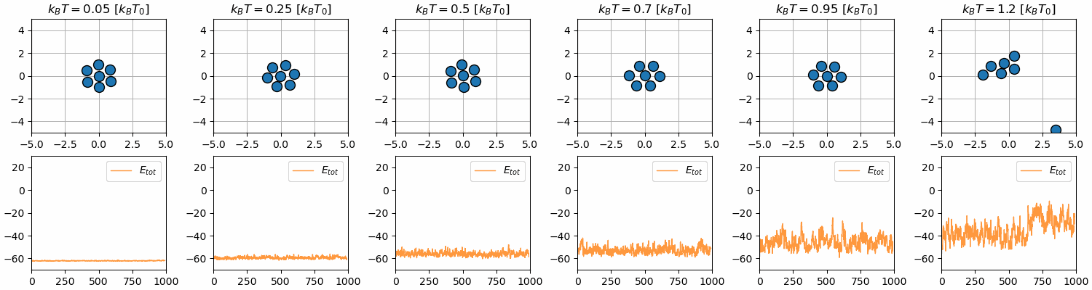
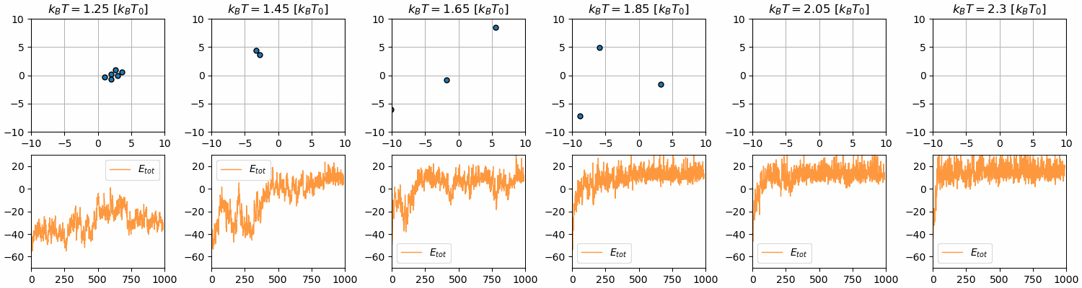
Exercise 27 – find phase transition

Slide 11
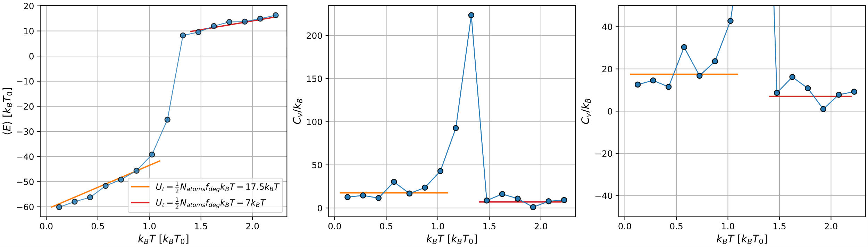
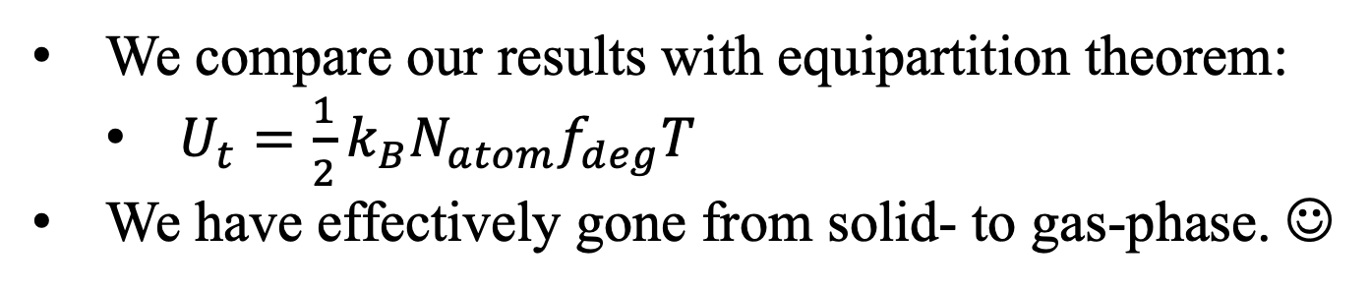
Exercise 27 – find phase transition
We compare our results with equipartition theorem:
$U_{t}=\frac{1}{2}k_{B}N_{atom}f_{deg}T$
We have effectively gone from solid- to gas-phase. ☺

Slide 12
Exercise 28 – Simulated annealing
Set up relaxed atoms → Heat up → Cool down (slowly)
Hopefully end up in more stable structure

Slide 13
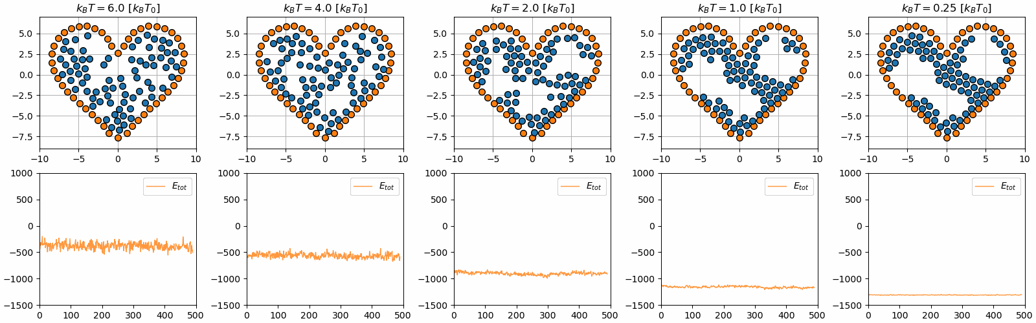

Slide 14
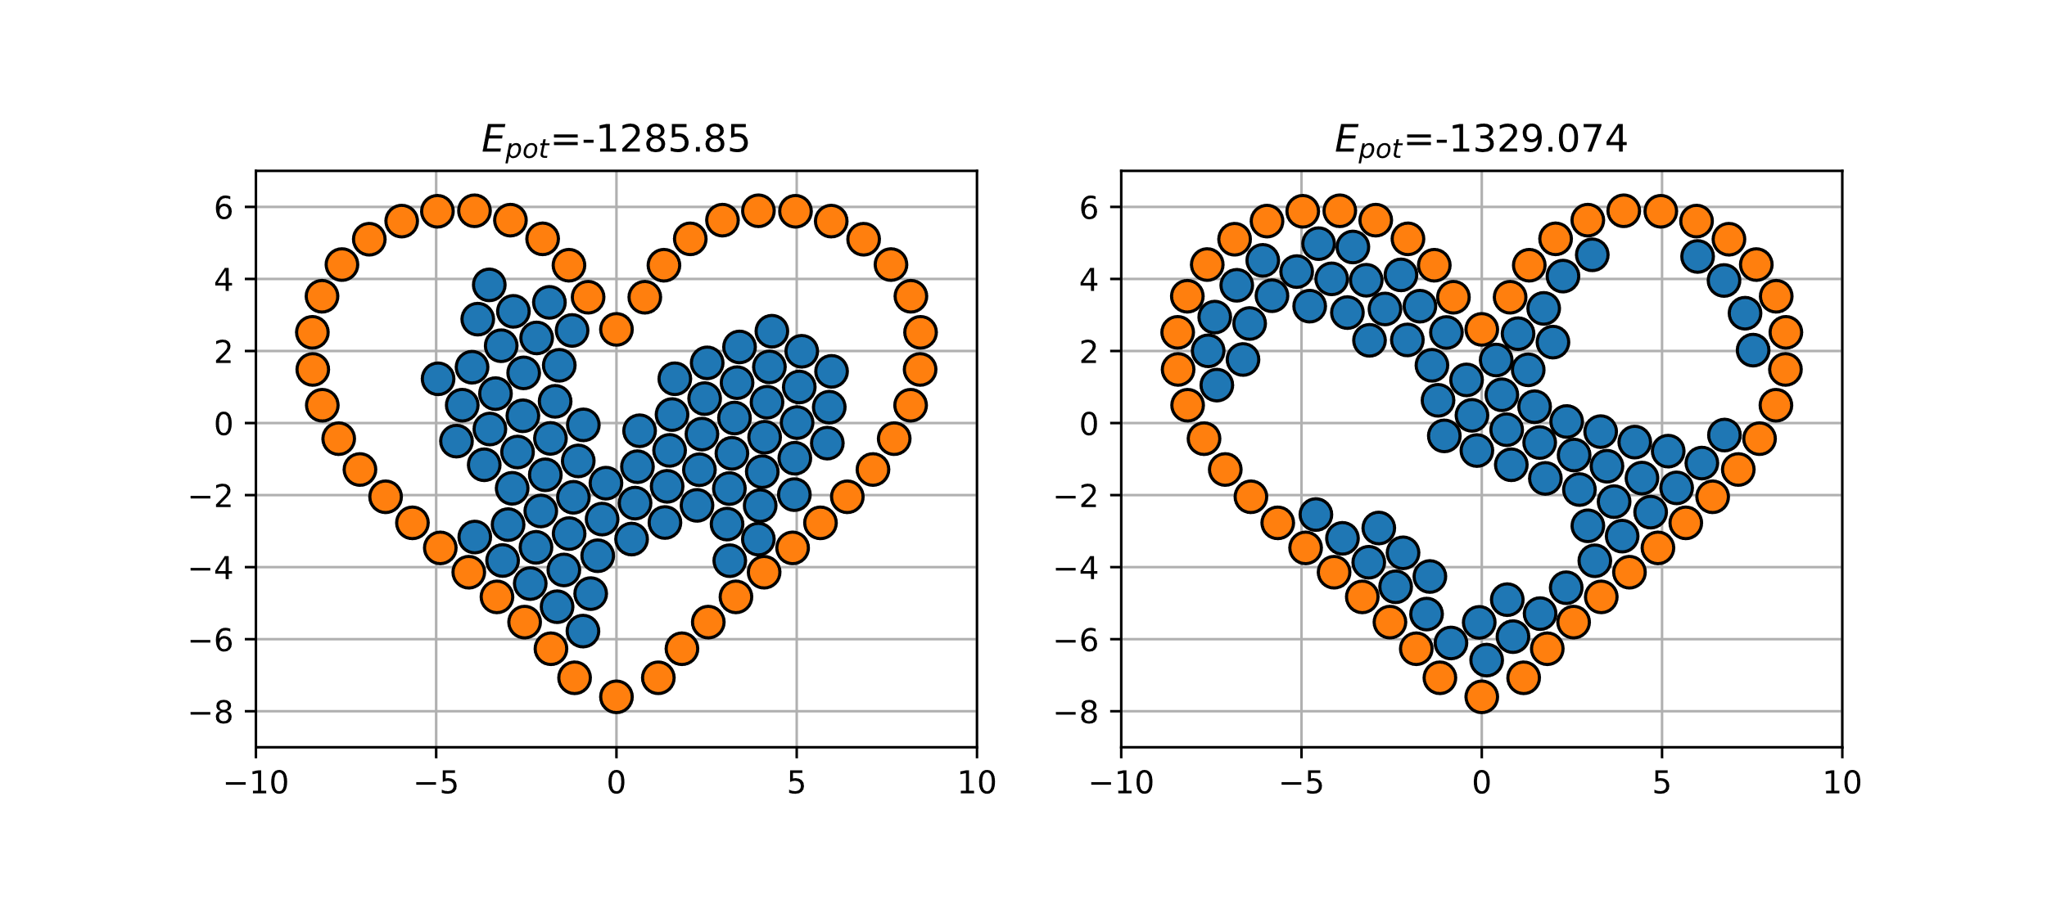
Exercise 28 – Simulated annealing
Finite simulation time

